Slide 1
Computer System Architecture COMP201TH
Lecture-3
Map Simplification (K-Map)
Part-I
(Canonical Normal Form- Minterm and Maxterm)
“I have not failed. I’ve just found 10,000 ways that won’t work.”
...Thomas A. Edison
Consensus Theorem/ Redundant Theorem of Boolean Algebra:
  AB + A`C + BC = AB +A`C
  Consensus theorem states that if you have a variable in one product
term and compliment of that variable in another product term and the third product term has the remaining variable from those two products then the third product term is redundant and we can eliminate this for simplification of Boolean expression.
Standard Form:
  If there exists at least one term that does not contain all variables →
Boolean expression is in standard form.
  E.g. F(A,B,C) = A` + ABC Here B and C variables are missing in first part of Boolean expression → expression is in standard SOP form.
Canonical Normal Form:
  Each term of Boolean expression contain all input variables either in True form or in complement form.
  In Boolean Algebra, any Boolean function can be put into:
    Canonical disjunctive normal form (CDNF) or minterm canonical form and
    Canonical conjunctive normal form (CCNF) or maxterm canonical form.
  A Boolean function can be expressed algebraically from a given truth table by forming a:
    Minterm for each combination of the variables that produces a 1 in the function and then taking the AND of all those
terms.
    Maxterm for each combination of the variables that produces a 0 in the function and then taking the OR of all those terms.

Slide 2
Minterm:
  A minterm of n variable is product of n literals in which each variable appears exactly once either in T or F form, but not in both.
    Minterms are called products because they are the logical AND of a set of variables.
  Each minterm has value 1 for exactly one combination of values of variables.
o E.g.: ABC (111) → m7
  A function can be written as a sum of minterms, which is referred to as a minterm expansion or a standard sum of products.
Maxterm:
  A maxterm of n variables is sum of n literals in which each variable appears exactly once in T or F form, but not in both.
    Maxterms are called sums because they are the logical OR of a set of variables.
  Each maxterm has a value of 0 for exactly one combination of values for variables.
  E.g.: A + B + C` (001) → M1 (the value is 0).
    Therefore; Mi = mi`
  A function can be written as a product of maxterms, which is
referred to as a maxterm expansion or a standard product of sums.
Example consider the following truth table:
A | B | C | F
0 | 0 | 0 | 0
0 | 0 | 1 | 0
0 | 1 | 0 | 0
0 | 1 | 1 | 1
1 | 0 | 0 | 1
1 | 0 | 1 | 1
1 | 1 | 0 | 1
1 | 1 | 1 | 1
Using f =1, gives the SOP form:
f = A`BC + AB`C` + AB`C + ABC` + ABC
= A`BC + AB` + AB
= A`BC + A
= A + BC (Using Rule 1 of Simplification Law)
Using f = 0, gives the POS form:
f = (A + B + C) (A + B + C`) (A + B` + C)
= (A +B) (A+B`+C)
= A + BC

Slide 3
Minterm Notation
Minterms present in f correspond with the 1’s of f in the truth table.
f = A`BC + AB`C` + AB`C + ABC` + ABC
Maxterm Notation
Maxterms present in f correspond with the 0’s of f in the truth table.
f = (A + B + C) (A + B + C`) (A + B` + C)
The other way to represent f is :
f(A,B,C) = m3+m4+m5+m6+m7
Or
f(A,B,C) = ∑m(3,4,5,6,7)
Another view:
f(A,B,C) = 0.m0+0.m1+0.m2+1.m3+1.m4+1.m5+1.m6
+1.m7
The other way to represent f is :
f(A,B,C) = M0M1M2
or
f(A,B,C) = π M(0,1,2)
 |  |  | * Remember *
Minterm (m) | ∑ | Sum of Product (SoP) | Take terms whose value is equal to 1 in the output of truth table. | Disjunctive Normal Form | A` = 0 A = 1
Maxterm (M) | Π | Product of Sums (PoS) | Take terms whose value is equal to 0 in the output of truth table. | Conjunctive Normal Form | A = 0 A` = 1

Slide 4
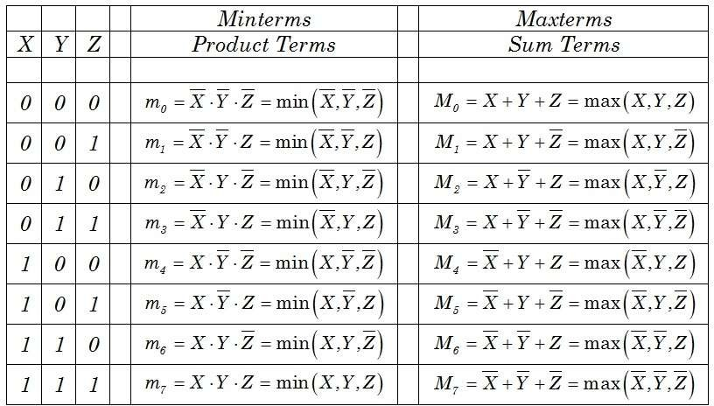
Truth table representing minterm and maxterm
Relation between m and M:
If the minterm expansion for f(A,B,C) = m3+m4+m5+m6+m7; what is the maxterm expansion for f(A,B,C)?
o Choose those not present in the minterms.
o
o So, the maxterm expansion for f(A,B,C) = M0M1M2
Q: Find the minterm expansion of following Boolean expression: f( A,B,C,D) = A`(B`+D)+ACD`
= A`B`+A`D`+ACD`
= A`B`(C+C`)(D+D`)+A`D(B+B`)(C+C`) + ACD`(B+B`)
=A`B`C`D`+A`B`C`D+A`B`CD`+A`B`CD+A`BC`D+A`BCD+ABCD`+AB`CD`
= 0000+0001+0010+0011+0101+0111+1110+1010
= ∑m (0,1,2,3,5,7,10,14)

Slide 5
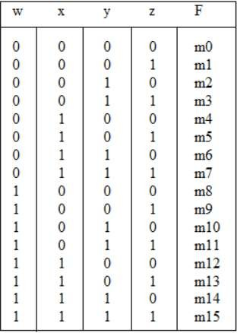
Q: Express the following function into sum of minterms maxterms:
f= (xy+z) (y+xz)
Sol:
f = (xy+z) (y+xz)
= xy.y+xy.xz+z.y+z.xz
=xy+xyz+zy+xz
=xy+yz+xz+xyz Now, consider the truth table of f:
and product of
x | y | z | f
0 | 0 | 0 | 0 | M0
0 | 0 | 1 | 0 | M1
0 | 1 | 0 | 0 | M2
0 | 1 | 1 | 1 | m3
1 | 0 | 0 | 0 | M4
1 | 0 | 1 | 1 | m5
1 | 1 | 0 | 1 | m6
1 | 1 | 1 | 1 | m7
f = 0.0 + 0.0 +0.0 +0.0.0 = 0 = M₀
f = 1.0+0.1+1.1+1.0.1= 1 =m₅
The corresponding minterms are given by: f = xy+yz+xz+xyz
= m3 + m5 +m6 +m7
= sum of minterms i.e. sum of products
The corresponding maxterms are given by:
f = (M0)(M1)(M2)(M4) = (x+y+z)(x+y+z`)(x+y`+z)(x`+y+z)

